Slide 1
9 - Queues

Slide 2
The ADT Queue
Like a line of people
  First person in line is first person served
  New elements of queue enter at its back
  Items leave the queue from its front
Called FIFO behavior
  First In First Out

Slide 3
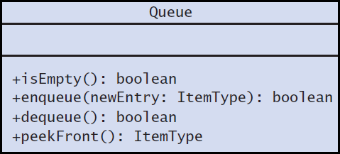
The ADT Queue
UML diagram for the class Queue

Slide 4
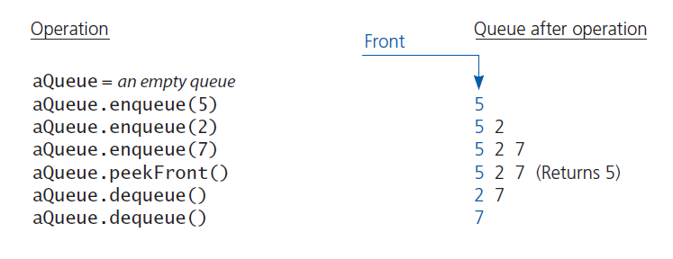
The ADT Queue
Some queue operations

Slide 5
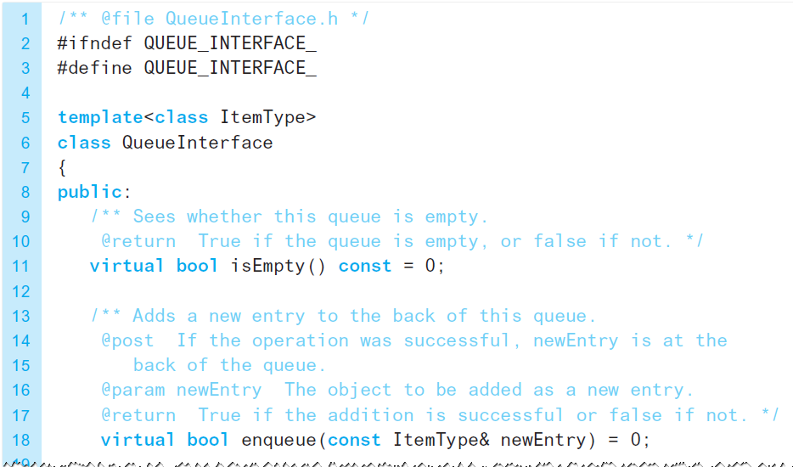
The ADT Queue
A C++ interface for queues

Slide 6
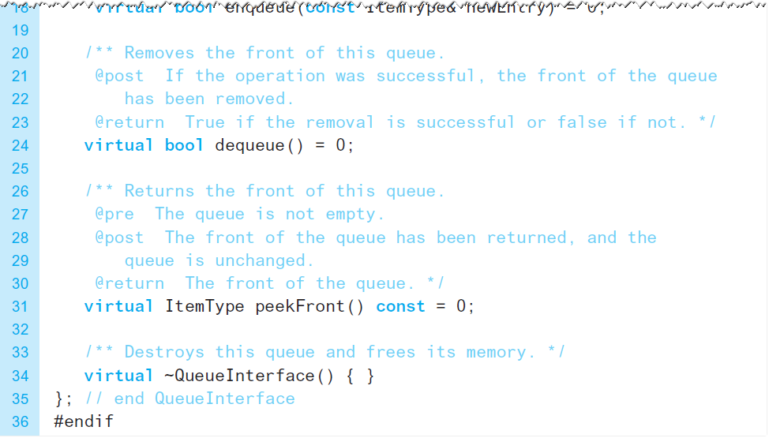
The ADT Queue
A C++ interface for queues

Slide 7
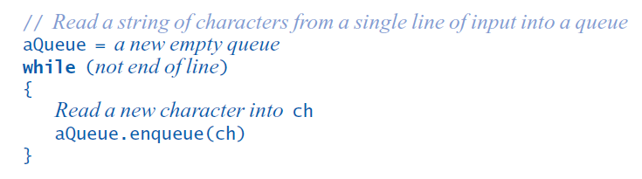
Applications
Reading a String of Characters
Pseudocode to read a string of characters into a queue.

Slide 8
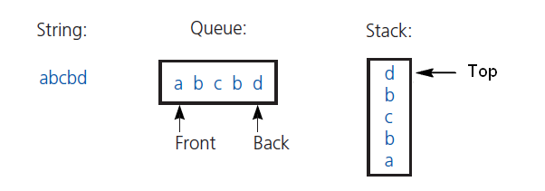
Applications
Recognizing a Palindrome
The results of inserting the characters a, b, c, b, d into both a queue and a stack
Remove characters from front of queue, top of stack
Compare each pair removed
If all pairs match, string is a palindrome

Slide 9
Position-Oriented and
Value-Oriented ADTs
Comparison of stack and queue operations
  Same
    isEmpty for both
    pop and dequeue
    peek and peekFront
    isFull for both
    makeEmpty for both
  Different
    push and enqueue

Slide 10
Position-Oriented and
Value-Oriented ADTs
ADT list operations generalize stack and queue operations
  getLength
  insert
  remove
  getEntry

